Slide 1

COMPUTER NETWORKS
(BCSC 0008)
Copyright content, use only with the written permission of presenter mentioned
Lecture 21

Slide 2
Text and Reference Books
Text Books:
Fourouzan B. A. (2004), “Data Communication and Networking”, 4th Edition, McGraw-Hill.
References:
Kurose, J. F. and Ross K. W. (2005), “Computer Networking: A Top-Down Approach Featuring the Internet”, 3rd Edition, Addison-Wesley.
A. S. Tanenbaum (2006), “Computer Networks”, 2nd Edition, Prentice Hall India.

Slide 3
TCP Window Management
Before discussing data transfer in TCP and the issues such as flow, error, and congestion control, we describe the windows used in TCP.
TCP uses two windows (send window and receive window) for each direction of data transfer, which means four windows for a bidirectional communication.
To make the discussion simple, we make an assumption that communication is only unidirectional;
The bidirectional communication can be inferred using two unidirectional communications with piggybacking.

Slide 4
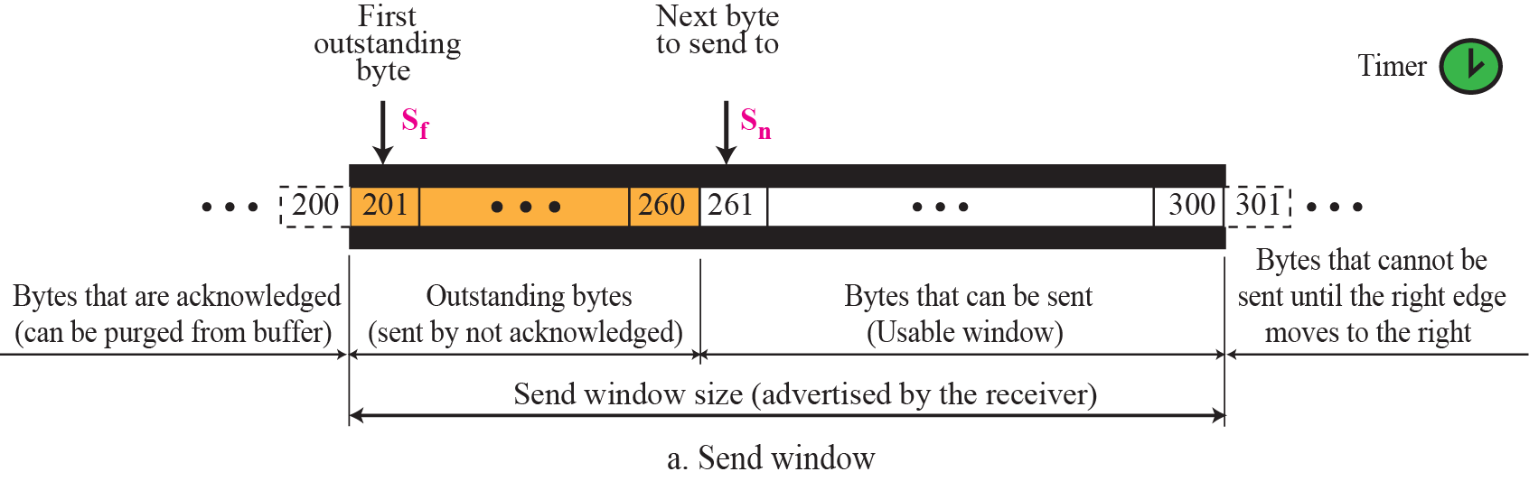
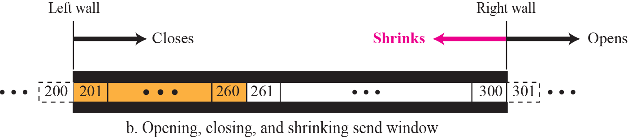
Figure 15.22 Send window in TCP

Slide 5
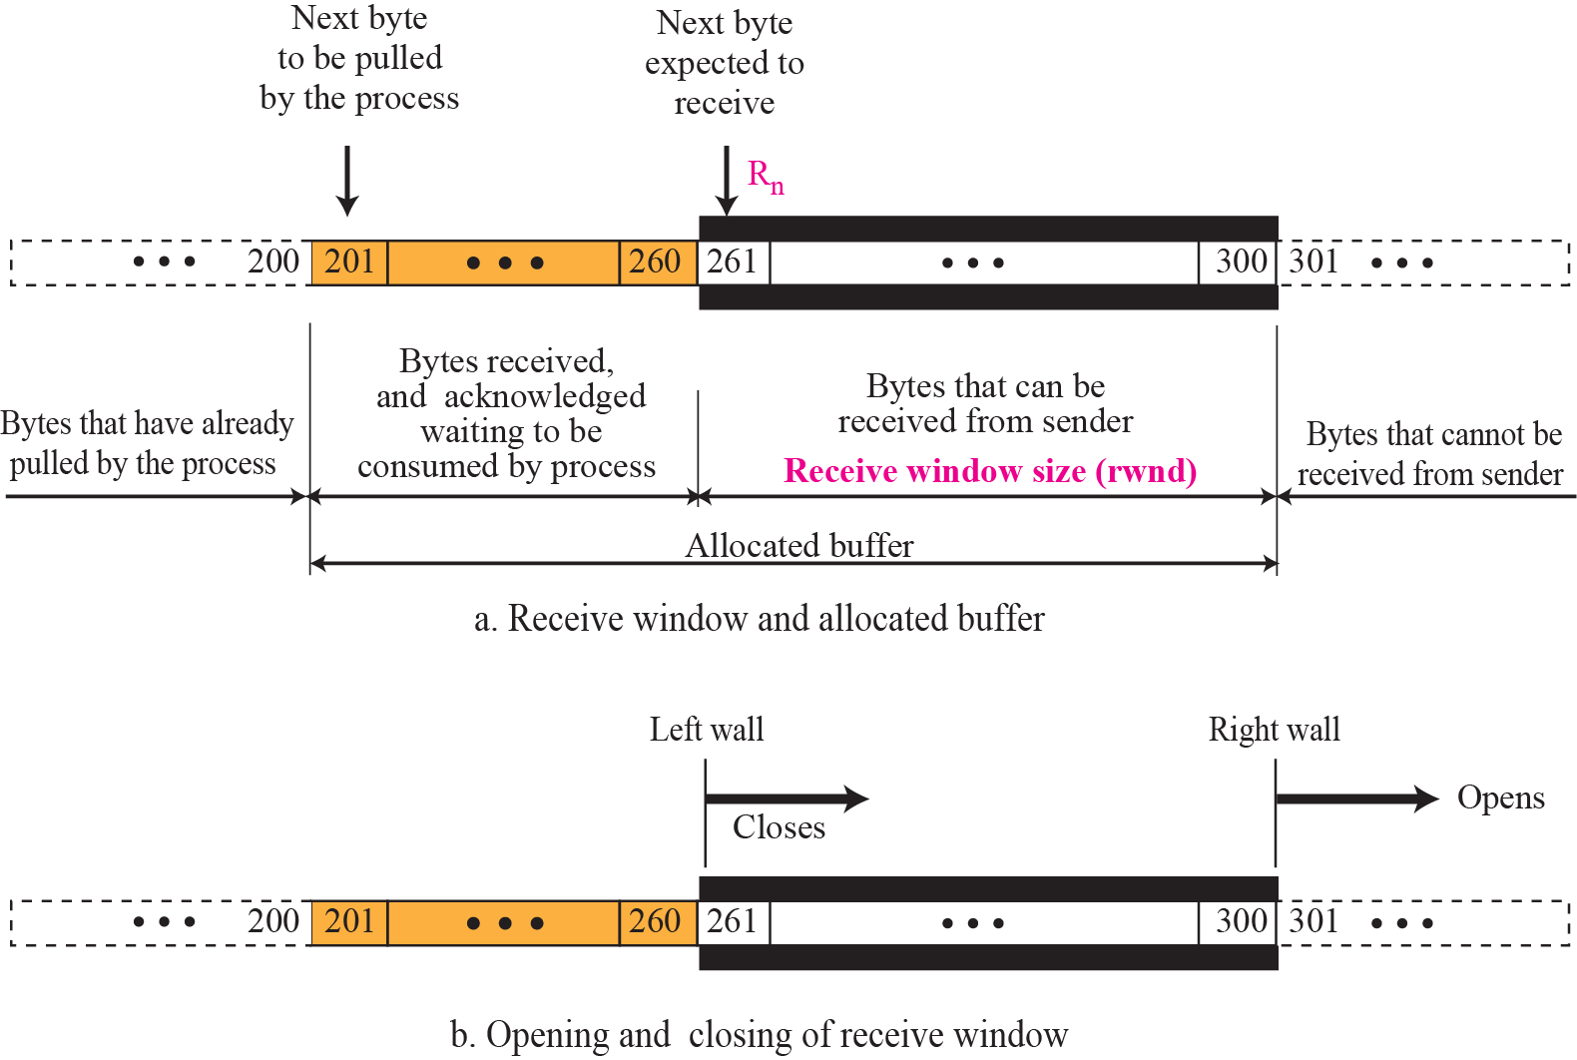
Figure 15.23 Receive window in TCP

Slide 6
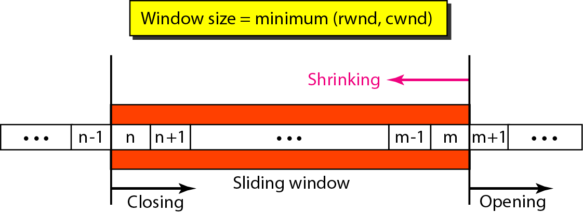
Figure 23.22 Sliding window

Slide 7

Note
A sliding window is used to make transmission more efficient as well as
to control the flow of data so that the destination does not become
overwhelmed with data.
TCP sliding windows are byte-oriented.

Slide 8
Example 23.4
What is the value of the receiver window (rwnd) for host A if the receiver, host B, has a buffer size of 5000 bytes and 1000 bytes of received and unprocessed data?
Solution
The value of rwnd = 5000 − 1000 = 4000. Host B can receive only 4000 bytes of data before overflowing its buffer. Host B advertises this value in its next segment to A.

Slide 9
Example 23.5
What is the size of the window for host A if the value of rwnd is 3000 bytes and the value of cwnd is 3500 bytes?
Solution
The size of the window is the smaller of rwnd and cwnd, which is 3000 bytes.

Slide 10
Example 23.6
Figure 23.23 shows an unrealistic example of a sliding window. The sender has sent bytes up to 202. We assume that cwnd is 20 (in reality this value is thousands of bytes). The receiver has sent an acknowledgment number of 200 with an rwnd of 9 bytes (in reality this value is thousands of bytes). The size of the sender window is the minimum of rwnd and cwnd, or 9 bytes. Bytes 200 to 202 are sent, but not acknowledged. Bytes 203 to 208 can be sent without worrying about acknowledgment. Bytes 209 and above cannot be sent.

Slide 11
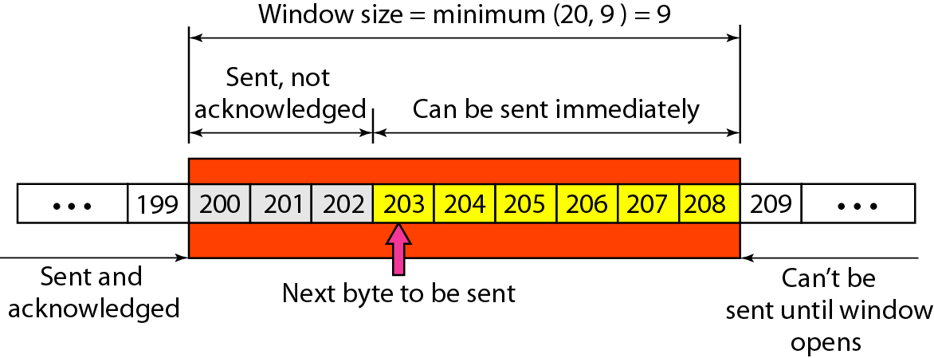
Figure 23.23 Example 23.6

Slide 12
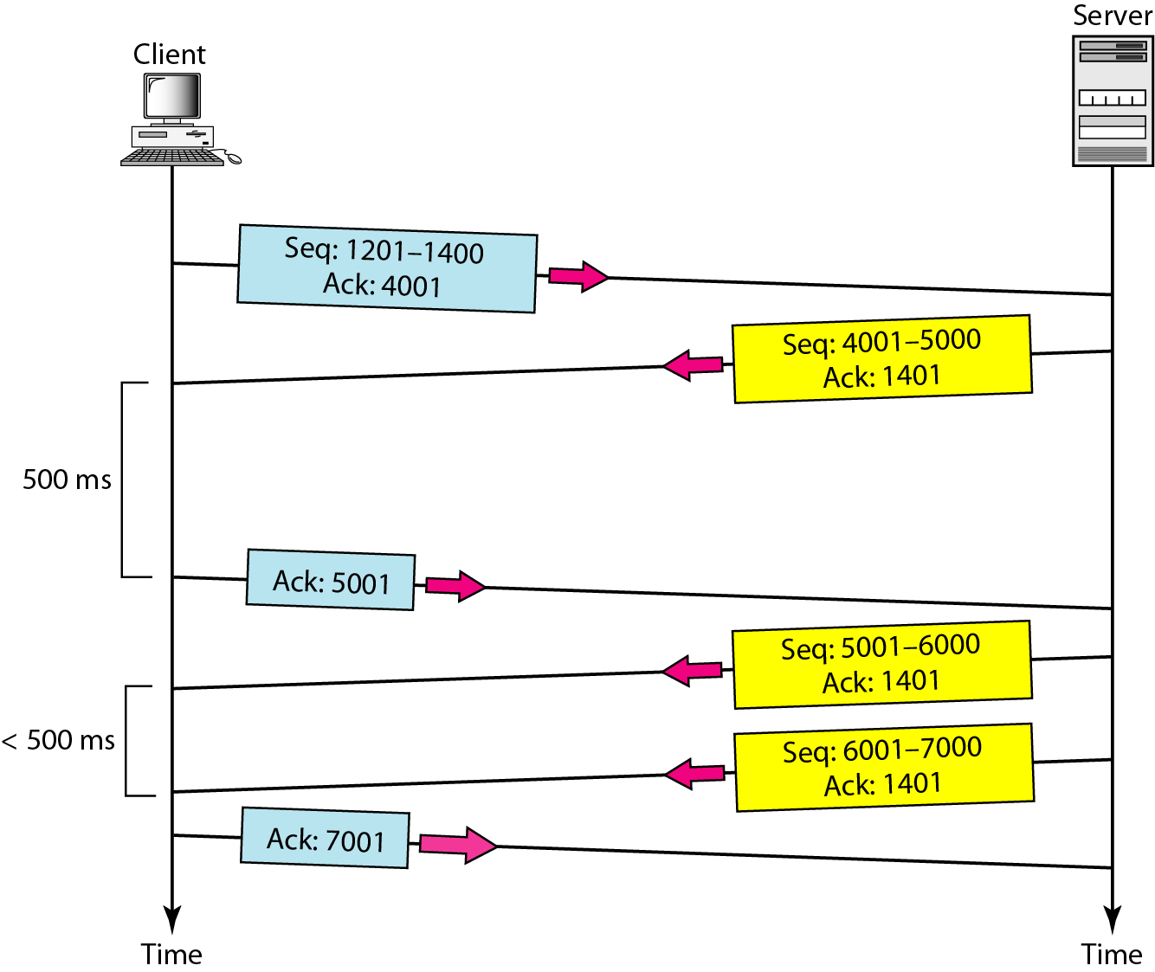
Figure 23.24 Normal operation

Slide 13
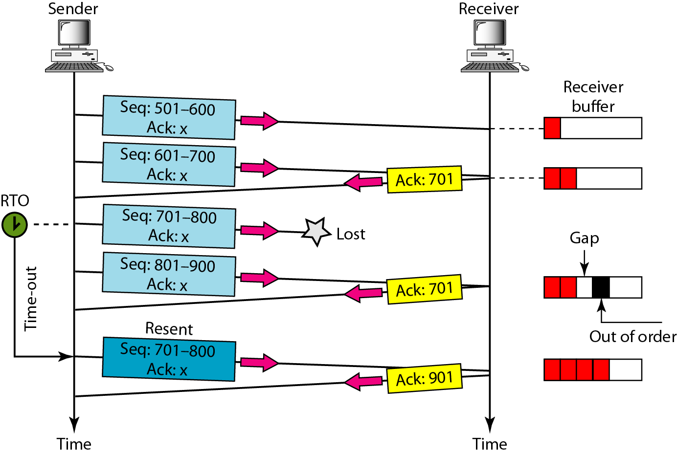
Figure 23.25 Lost segment

Slide 14
Note
The receiver TCP delivers only ordered data to the process.

Slide 15
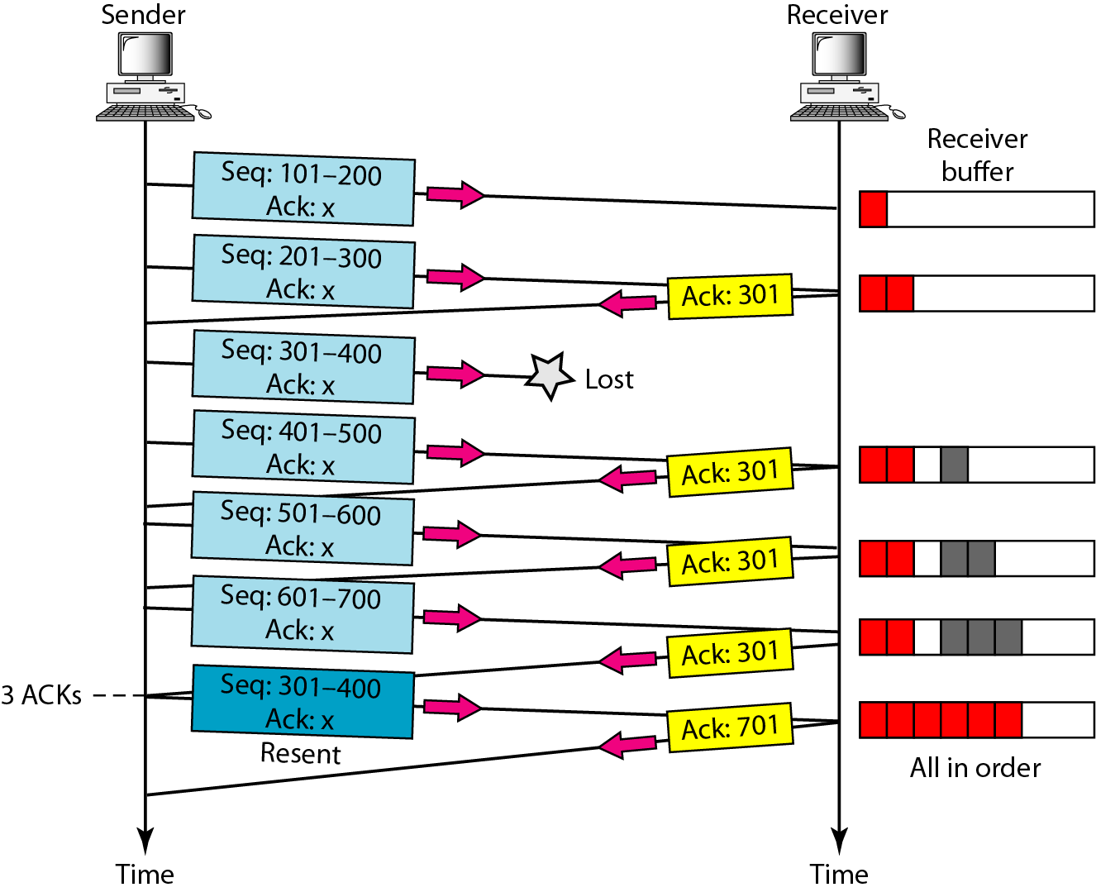
Figure 23.26 Fast retransmission

Slide 16
15-9 CONGESTION CONTROL
Congestion control in TCP is based on both open loop and closed-loop mechanisms. TCP uses a congestion window and a congestion policy that avoid congestion and detect and alleviate congestion after it has occurred.

Slide 17
Congestion Control Introduction:
When too many packets are present in (a part of) the subnet, performance degrades. This situation is called congestion.
As traffic increases too far, the routers are no longer able to cope and they begin losing packets.
At very high traffic, performance collapses completely and almost no packets are delivered.
Reasons of Congestion:
  Slow Processors.
  High stream of packets sent from one of the sender.
  Insufficient memory.
  High memory of Routers also add to congestion as becomes un manageable and un accessible. (Nagle, 1987).
  Low bandwidth lines.
Then what is congestion control? Congestion control has to do with making sure the subnet is able to carry the offered traffic.
Congestion control and flow control are often confused but both helps reduce congestion.

Slide 18
Knowledge of congestion will cause the hosts to take appropriate action to reduce the congestion.
For a scheme to work correctly, the time scale must be adjusted carefully.
If every time two packets arrive in a row, a router yells STOP and every time a router is idle for 20 µsec, it yells GO, the system will oscillate wildly and never converge.
Dividing all algorithms into
  open loop or
  closed loop
They further divide the open loop algorithms into ones that act at the source versus ones that act at the destination.
The closed loop algorithms are also divided into two subcategories:
  explicit feedback implicit feedback.
  In explicit feedback algorithms, packets are sent back from the point of congestion to warn the source.
  In implicit algorithms, the source deduces the existence of congestion by making local observations, such as the time needed for acknowledgements to come back.
The presence of congestion means that the load is (temporarily) greater than the resources can handle.
Solution?
  increase the resources or
  decrease the load.
That is not always possible. So we have to apply some congestion prevention policy.

Slide 19
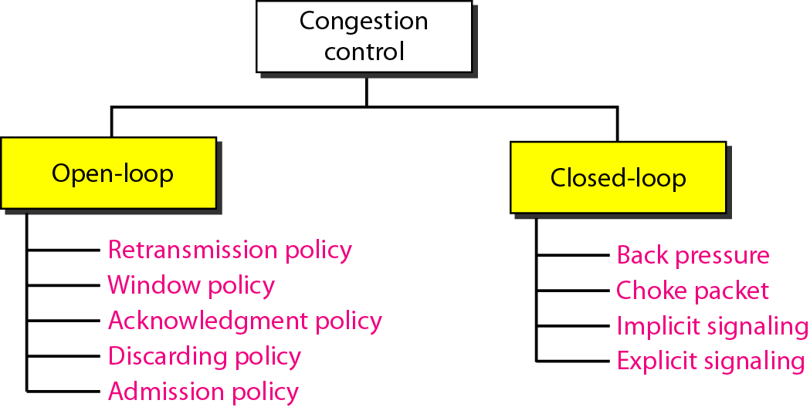
Figure 24.5 Congestion control categories

Slide 20
Congestion Control in TCP
Slow Start
Additive Increase (Congestion Avoidance)
Multiplicative decrease

Slide 21
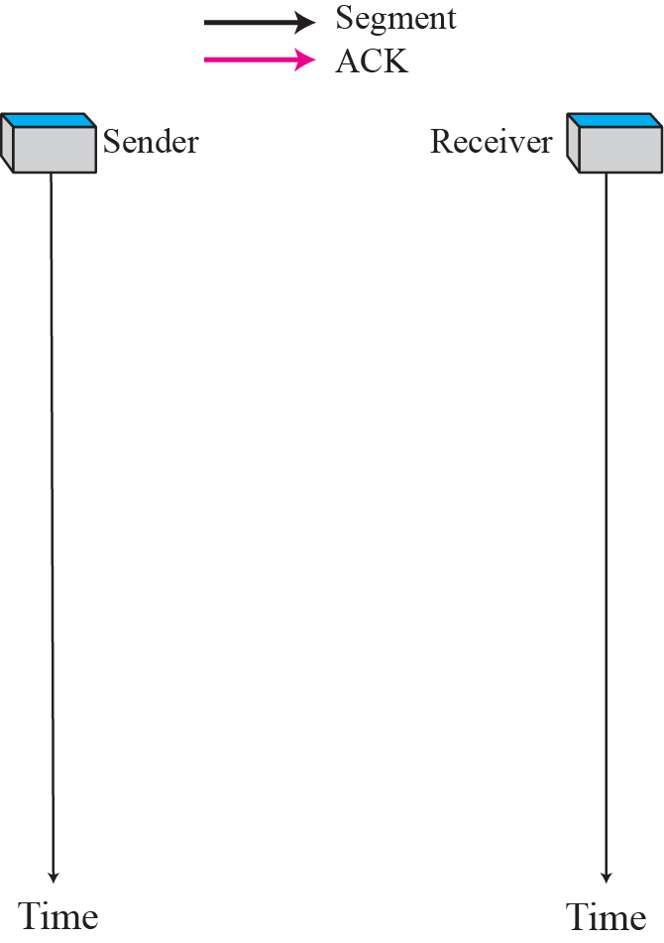
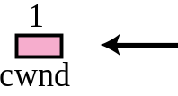
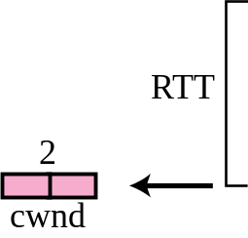
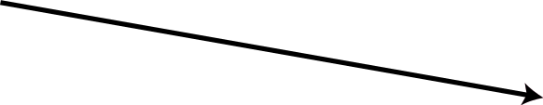

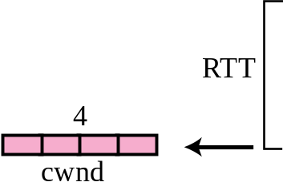
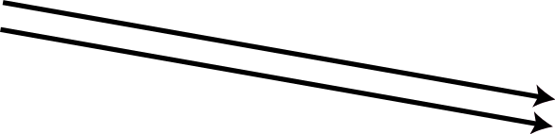
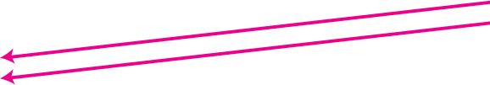
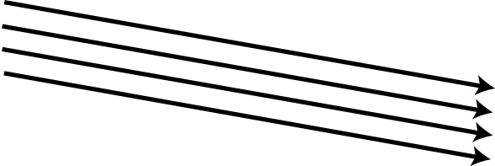
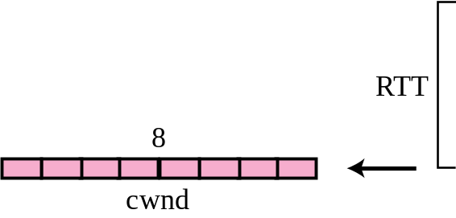
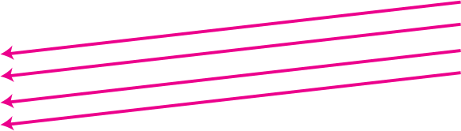
Slow start, exponential increase

Slide 22
Note
In the slow start algorithm, the size of the congestion window increases exponentially until it reaches a threshold (ssthresh).

Slide 23
What will happen reaches to threshold
ssthresh=window/2
Cwnd=ssthresh

Slide 24
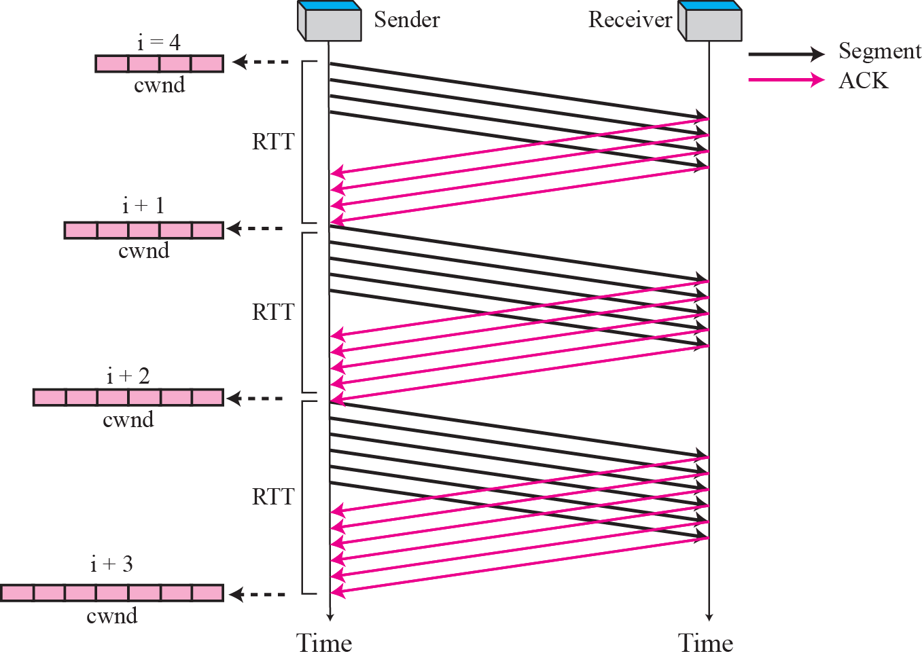
Figure Congestion avoidance, additive increase

Slide 25
Note
In the congestion avoidance algorithm the size of the congestion window
increases additively until
congestion is detected.

Slide 26
What will happen reaches to threshold
Congestion is detected by timeout
ssthresh=window/2
cwnd=1

Slide 27
Multiplicative Decrease
Congestion is detected by 3 dup Acks
ssthresh=window/2
cwnd=ssthresh

Slide 28
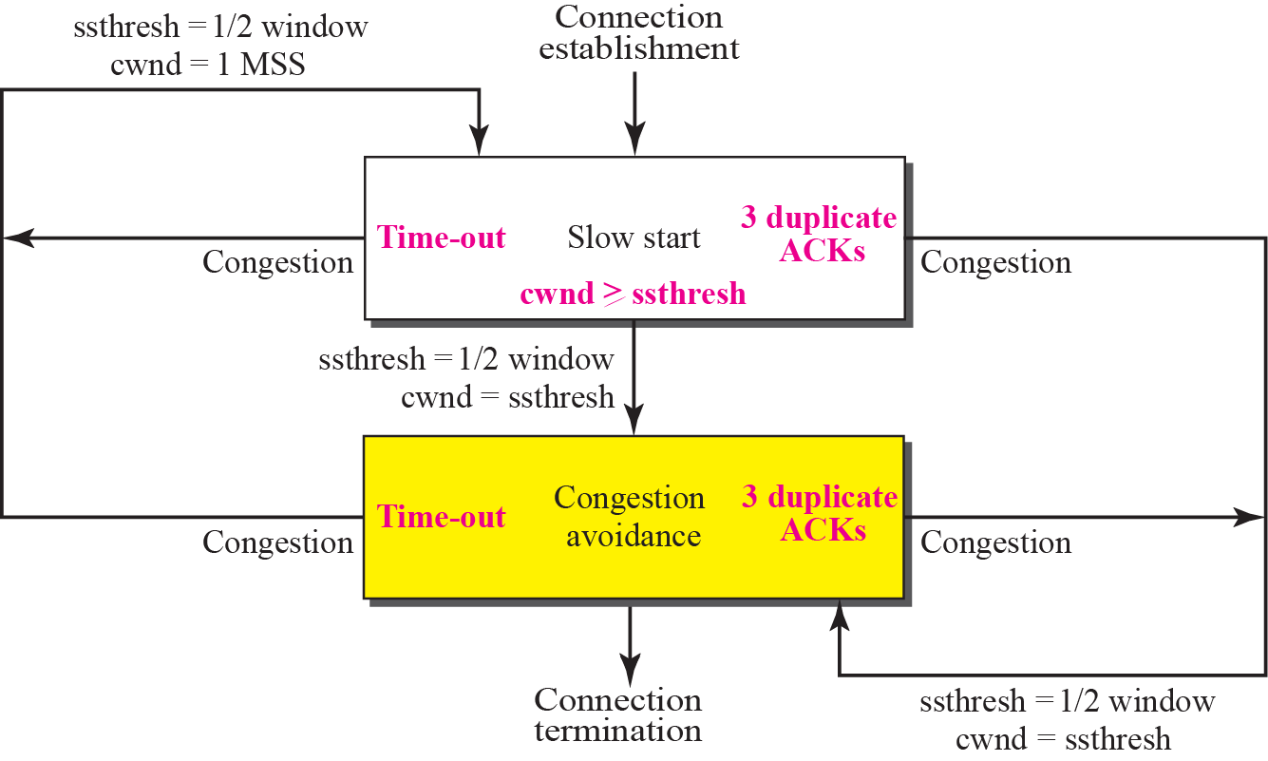
TCP Congestion policy summary

Slide 29
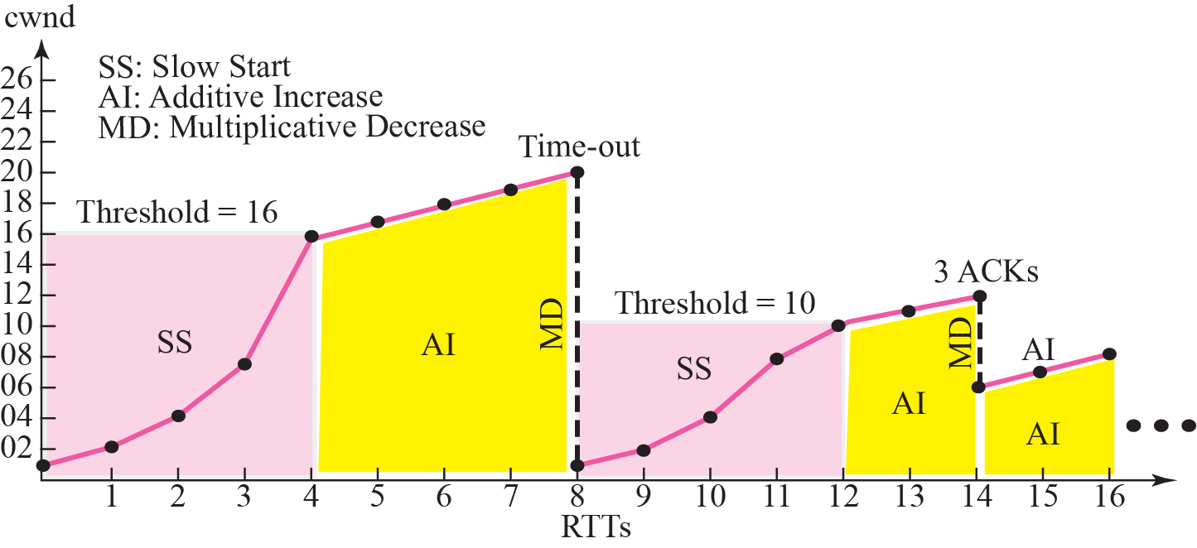
Figure 15.37 Congestion example

